Slide 1
A Community Aware Search Engine
Rodrigo B. Almeida and Virgılio A. F. Almeida
Venue: WWW’04
Discovering and Using Groups to Improve Personalized Search
Jaime Teevan, Meredith Ringel Morris and
Steve Bush
Venue: WSDM’09

Slide 2
Introduction of the Paper
Novel ranking technique for personalized search combining content-based and community-based evidences
Bayesian belief networks used to combine the two sources
Data used from Amazon (an online bookstore) ranging 1st August to 14th August 1999

Slide 3

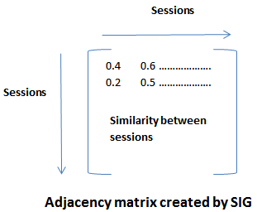
Community Identification (Session Interest-based Graphs)

Slide 4
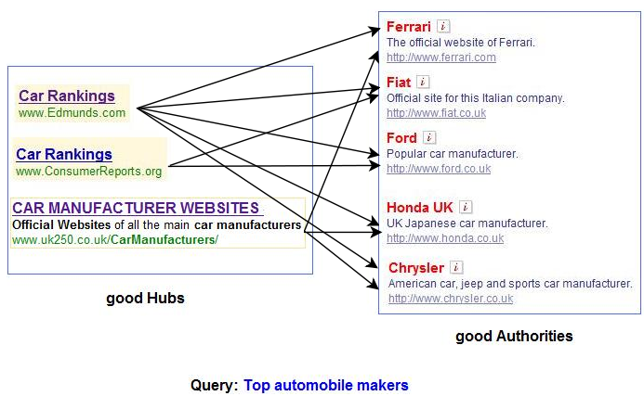
Community Identification (HITS Algorithm)
Taken from: http://www.math.cornell.edu/~mec/Winter2009/RalucaRemus/Lecture4/lecture4.html
Notes:
Topics contained embedded links of authority and hub to create a community

Slide 5
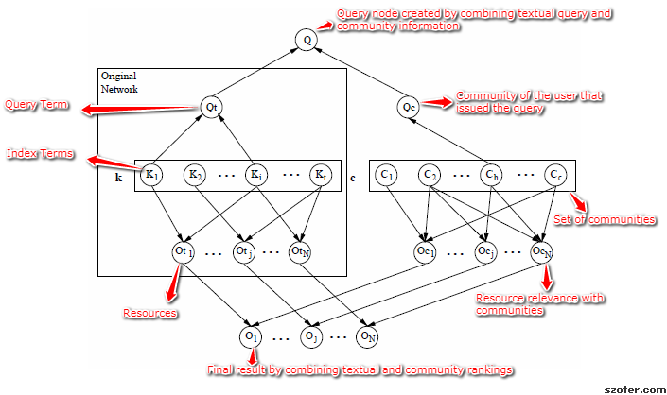
Combining Content and Community Information (Bayesian Belief Model)
Notes:
Bayesian belief networks allows to represent relationships between random variables

Slide 6

Vectorial Ranking for query “system administration”

Slide 7

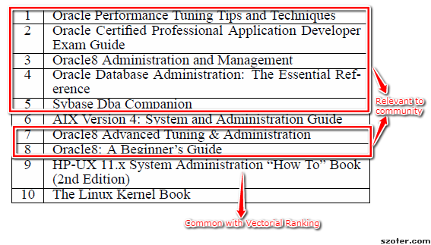
Comparison between Vectorial ranking and C₅ ranking

Slide 8
Normalized Ranking
Dataset of 10 objects
Session s accessed objects o₁, o₂ and o₃
Best and worst communities for session s are c_{b} and c_{w}
In C_{b} - o₁ appeared at 3rd position, o₂ at 6th position and o₃ at 8th position
Normalized Ranking Position
Best Ranked Object – 30%
Average Object – 50%
Worst Ranked Object – 80%

Slide 9
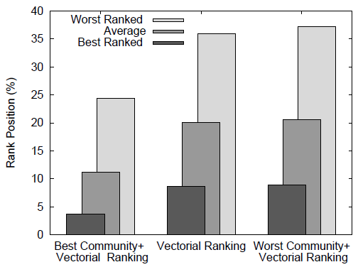
Normalized rank positions over all queries

Slide 10
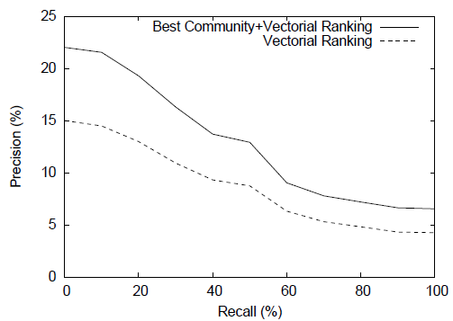
Precision vs Recall evaluation

Slide 11
Conclusion of the Paper
Introduced Session Interest-based Graphs for community identification
Proposed a community-based ranking algorithm
Community-based algorithm has 48% improvement in precision over Vectorial ranking
80% improvement in Normalized Ranking for best community over content-based search

Slide 12
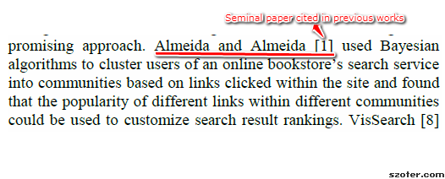
Why the Second Paper Cites the First Paper
Uses a group-based personalization model similar to community-based personalization model

Slide 13
Overview of the Citing Paper
Group users on dimensions of longevity of the group members’ relationship and how explicitly the group is formed
Find the effect of groupings to understand relevant results for users
Explore an algorithm to personalize web search results to show significant improvement on group-relevant queries

Slide 14
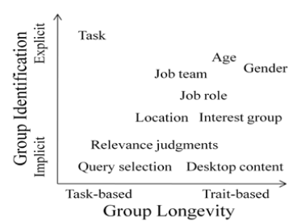
Groups studied in the paper

Slide 15
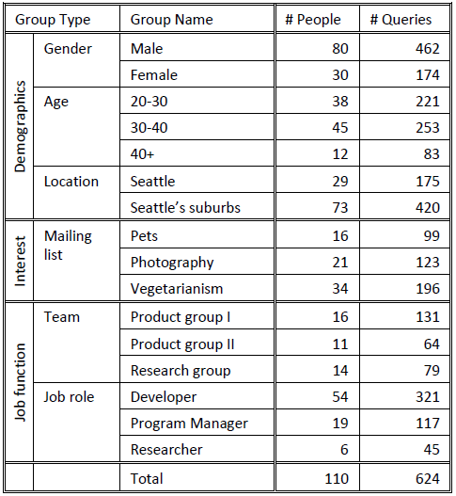
Dataset of participants comprising of trait-based groups

Slide 16
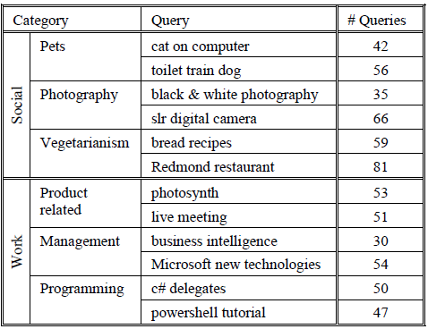
Trait-based groups’ relevance judgments

Slide 17
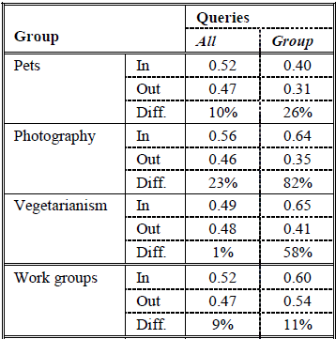
Similarity among user profiles

Slide 18
Groupization Algorithm
Implemented groupized algorithm on top of an existing Web search personalization system
Groupized score for each of the top 40 results to each query was computed for a group by summing the personalized score for that query across each group member

Slide 19
Personalization System Algorithm
Finds similarity between the result’s text content and the user’s profile
Finds similarity of the result’s URL to previous URL visited by the user

Slide 20
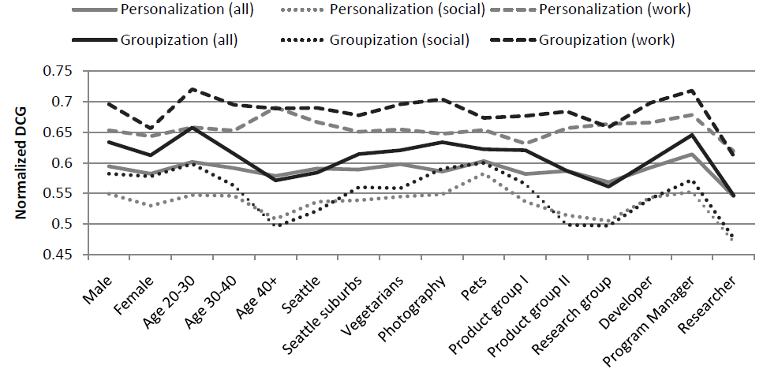
Performance of Groupization Algorithm for trait-based groups

Slide 21
Conclusion of the Paper
Groupization is better than personalization for explicit groups and group-related queries
Users with similar interests are likely to generate similar queries on similar topics
Query choice is useful in determining group membership of user when membership is not known a priori

Slide 22
Identifying best and worst Community for each session
Participation of node s in community c represented by a _{s,c}
a _{s,c} - Authority weight for each session in each community
Best communities have high value of a _{s,c}
Worst communities have low value of a _{s,c}

